Slide 1

Course Code: MATH 211
Course Title: MATH III
Lecture 4 (Inverse Laplace Transform)
Tazin Tamanna
Lecturer in Mathematics
Department of Science and Humanities
M.Sc. in Applied Mathematics (KU)
B.Sc. in Mathematics (KU)

Slide 2

Inverse Laplace Transform
Definition

Slide 3

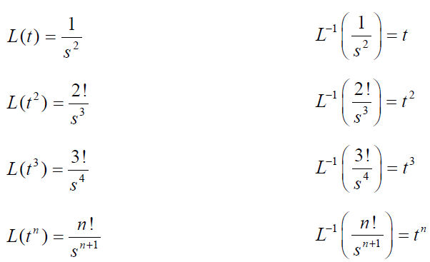


Slide 4
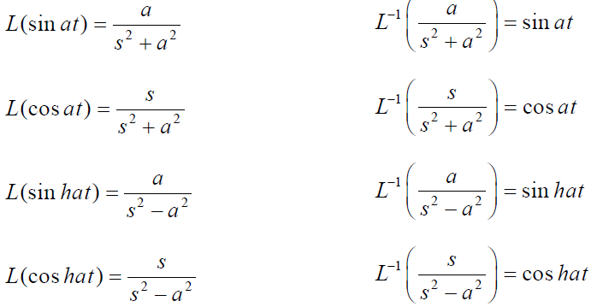


Slide 5

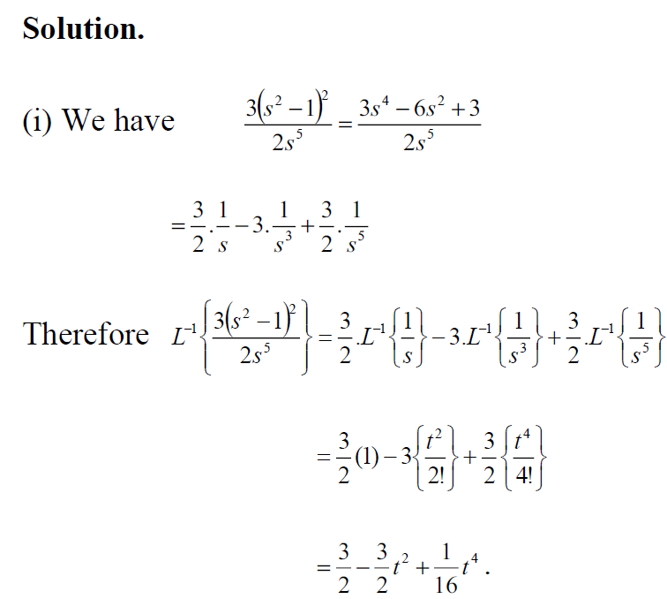

Slide 6
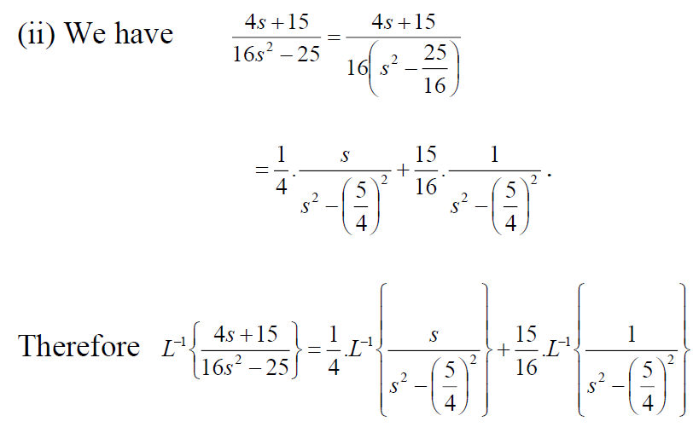
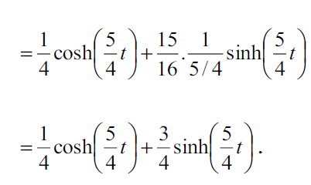

Slide 7
Do Yourself

Slide 8
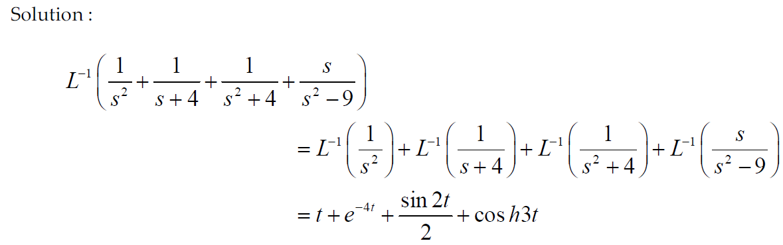

Slide 9
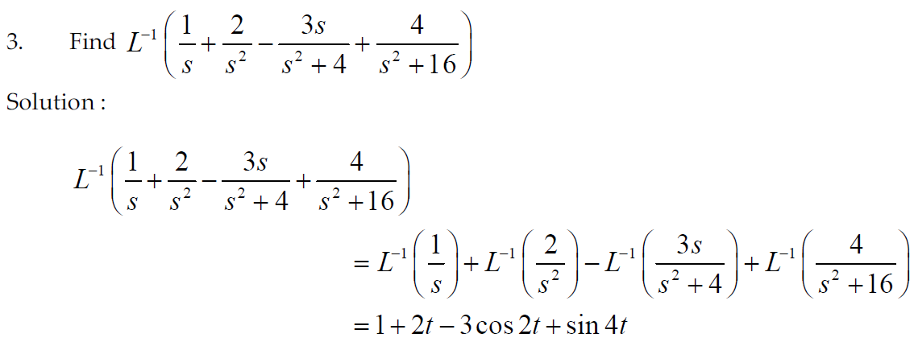
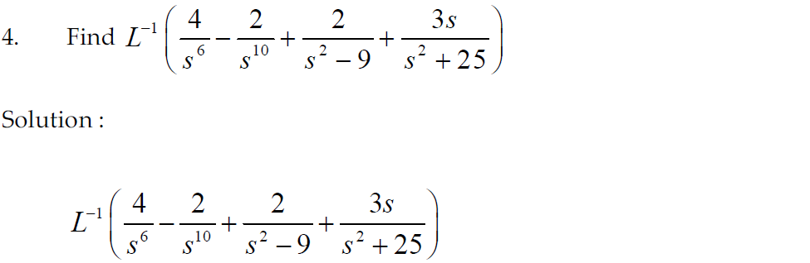


Slide 10
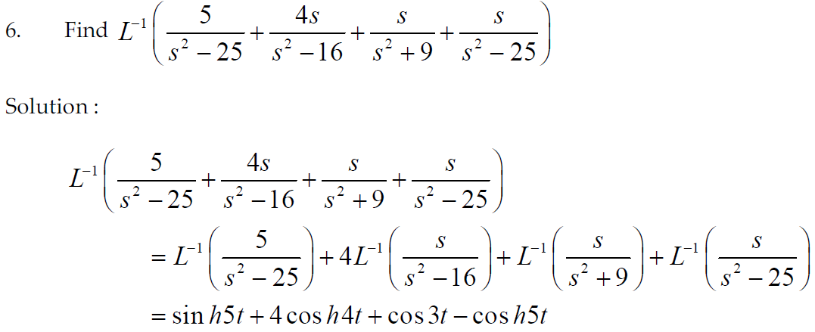
5.

Slide 15
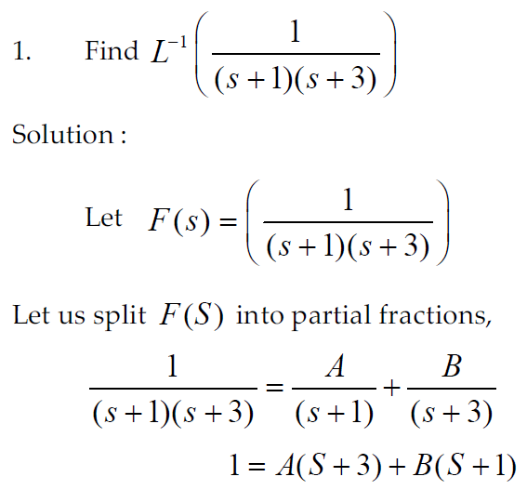

Slide 16
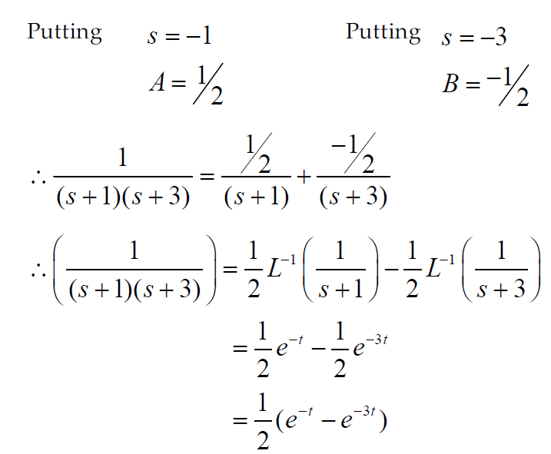

Slide 17
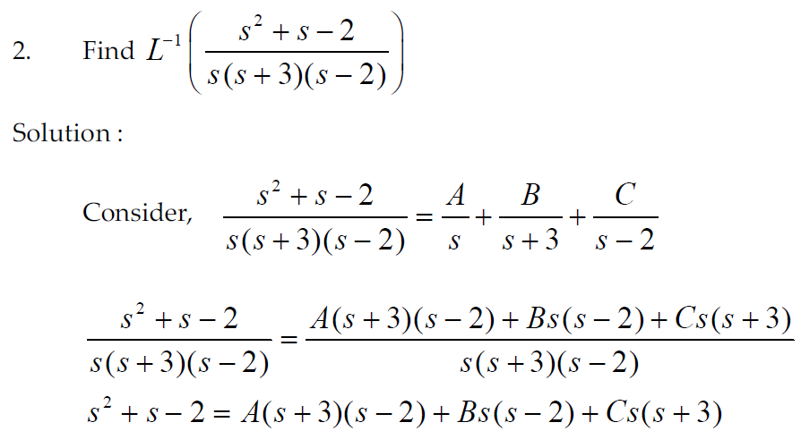

Slide 18
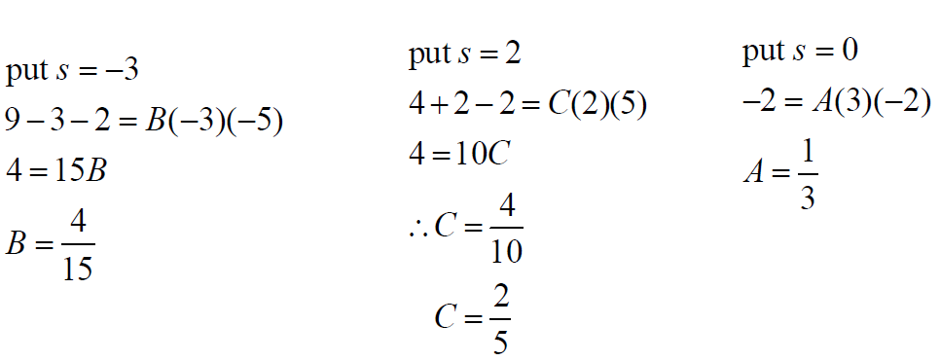


Slide 19
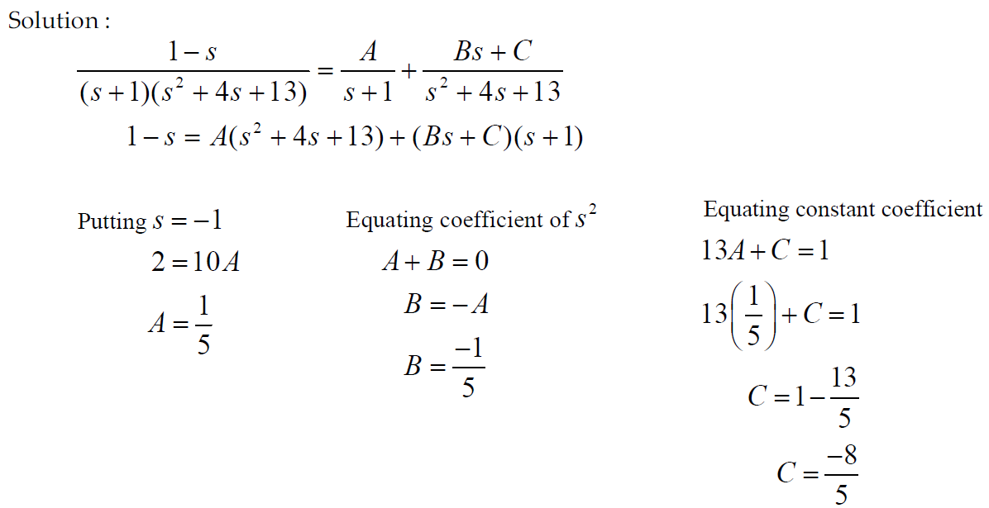
3.

Slide 20
